Slide 1
Pattern Recognition and Machine learning
Project : Facial Analytics for BMI Prediction and Gender Classification
Done by:
G.SriRam CS22B2020
T.Madan CS22B2023
Harsha CS22B2024

Slide 2
Project Overview
Objective: To develop model that predicts BMI and classifies gender based on front and side view images of individuals.
Approach: A multi-task model using Convolutional Neural Networks (CNNs) for feature extraction from images and regression for BMI prediction and gender classification.
Problem Statement
BMI Prediction: Body Mass Index (BMI) is a key health indicator, and predicting it from images could assist in health assessments.
Gender Classification: Accurate gender classification based on images could have applications in various fields like personalized health or demographics.
Challenge: The large dataset of images requires an efficient model and proper data management techniques to prevent memory overload.

Slide 3
Explored Methods:
Bayes Classifier: Struggled with image data due to assumptions of feature independence.
SVM: Inefficient with high-dimensional data from images; kernel selection was challenging.
KNN: High computational cost for large datasets and lacks feature extraction capabilities.
Clustering Algorithms: Unable to provide sufficient discriminative features for regression/classification tasks.
Challenges with Traditional Methods:
Limited ability to handle high-dimensional, complex data like images.
Feature extraction from raw image data was labor-intensive and suboptimal.
Why Convolutional Models?
Automated Feature Extraction: Captures spatial and hierarchical features directly from images.
Effective for Image Data: Handles high-dimensional input efficiently without manual feature engineering.
Robustness: Performs well for both regression (BMI) and classification (gender).

Slide 4
Data Collection and Preprocessing
Data Source: A CSV file (person.csv containing person information (ID, height, weight, sex)).
Steps Taken:
Converted height (in inches) to meters and weight (in pounds) to kilograms.
Calculated BMI using the formula: BMI = weight(kg) / height(m)^2.
Gender encoding: Male = 1, Female = 0.
Image paths were added to the DataFrame for both front and side images.
Preprocessed images to the required size (224x224 pixels).
Removed corrupted or missing images.
Data Storage and Management
Handling Large Dataset:
Converted images into numpy arrays to store them for efficient loading during training.
Saved images and associated labels (BMI, gender) into separate numpy arrays in batches to avoid memory overload.
Saved the processed DataFrame with paths to images and corresponding information (processed_data.csv).

Slide 5
Model Architecture
Dual-Input CNN Model:
Two input images: front and side views of a person.
CNN for Image Processing: Each image input (front and side) is passed through separate CNN branches:
Convolutional layers (Conv2D) for feature extraction.
Max pooling layers (MaxPooling2D) for dimensionality reduction.
Flatten layer to convert the 2D features into 1D.
Feature Combination: Outputs of both branches are concatenated using Concatenate().
Output Layers:
BMI Prediction: A dense node with linear activation.
Gender Classification: A dense node with sigmoid activation.

Slide 6
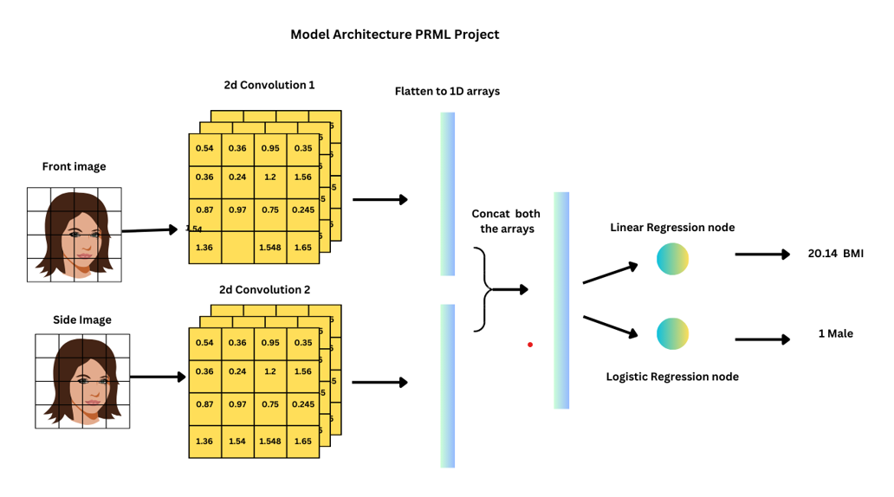
Model Architecture

Slide 7
Model Compilation
Optimizer: Adam optimizer for efficient training.
Loss Functions:
BMI Prediction: Mean Squared Error (MSE) loss.
Gender Classification: Binary Crossentropy loss.
Metrics:
BMI: Mean Absolute Error (MAE), MSE,R^2,Pearson Coefficient.
Gender: Accuracy.
Training the Model
Training Process:
Split data into training (80%) and validation (20%) sets.
Utilized a custom data generator to load image data in batches to manage memory effectively.
Used a ModelCheckpoint callback to save the best model based on validation loss.
Steps per Epoch: Calculated based on batch size and total number of samples.
Epochs: Trained the model for 40 epochs.

Slide 8
Evaluation and Results
Model Evaluation:
Trained model was evaluated by randomly selecting 10 images and inferencing on them
Predicted BMI and gender for random samples from the dataset.
Displayed images with predictions and actual values.
Metrics:
BMI: Predicted BMI values were compared with actual BMI values using metrics like MAE and MSE.
Gender: Accuracy of gender classification was computed.

Slide 9
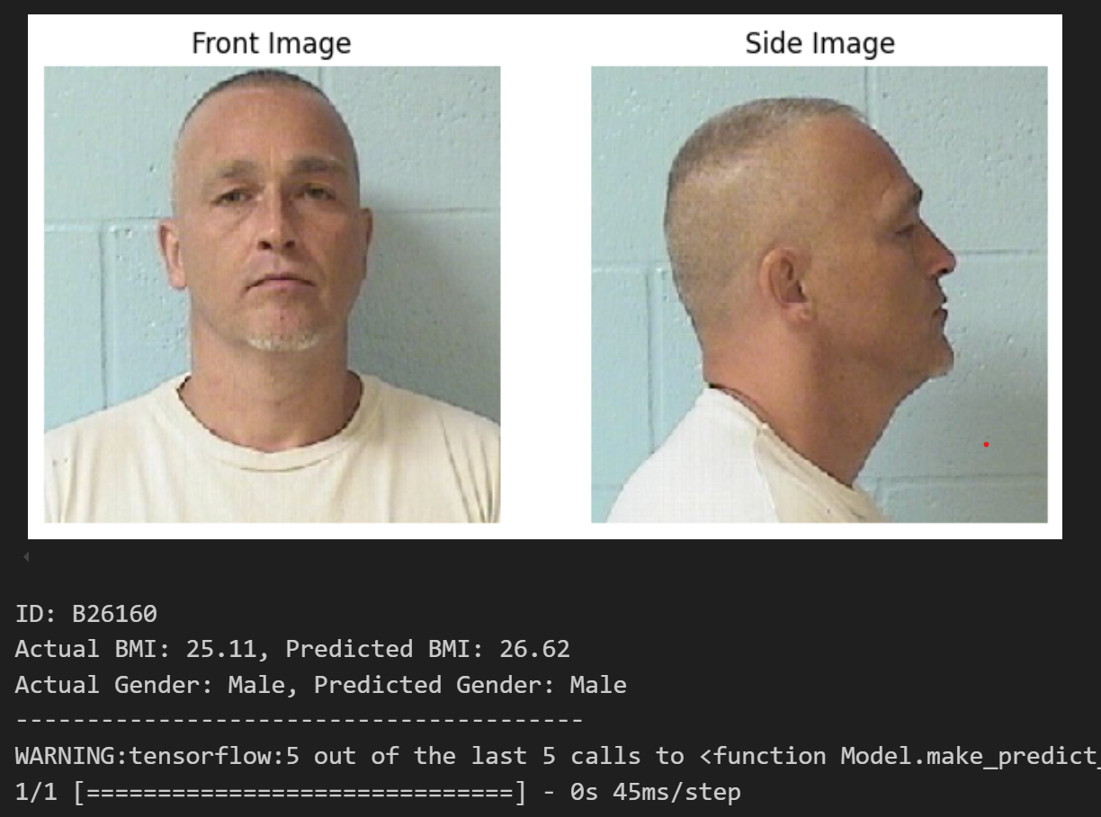
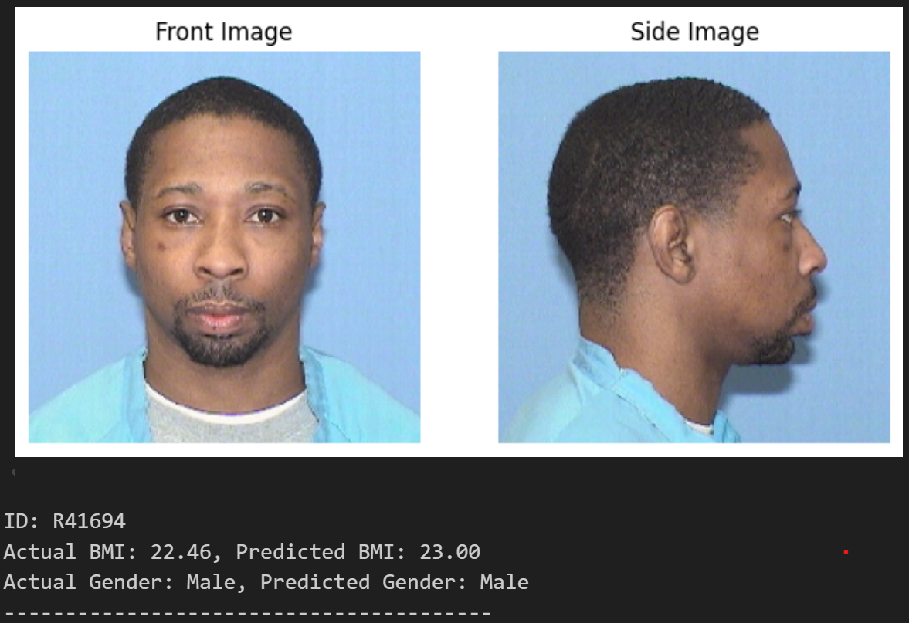
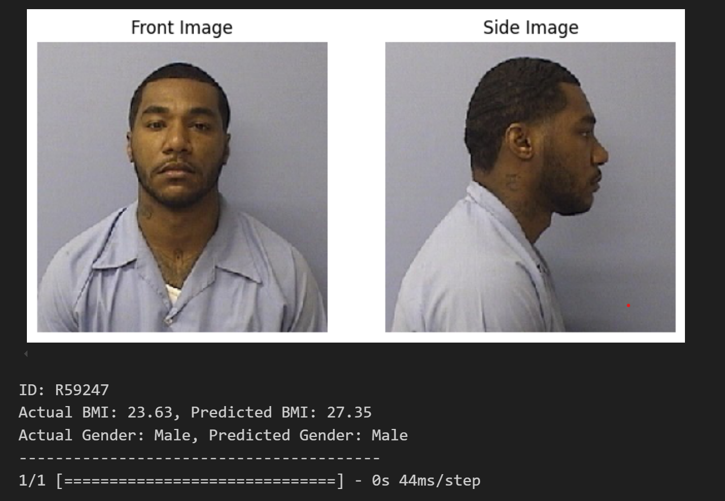
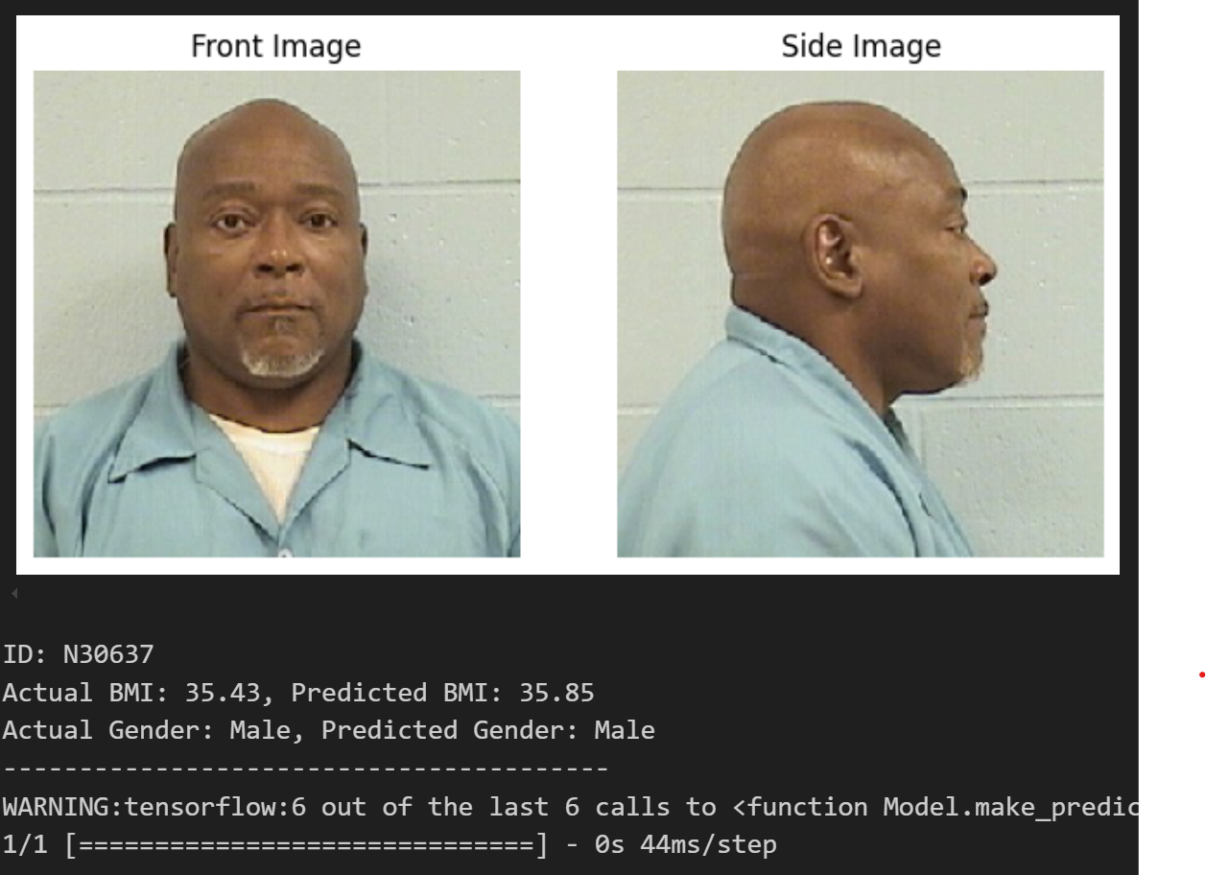
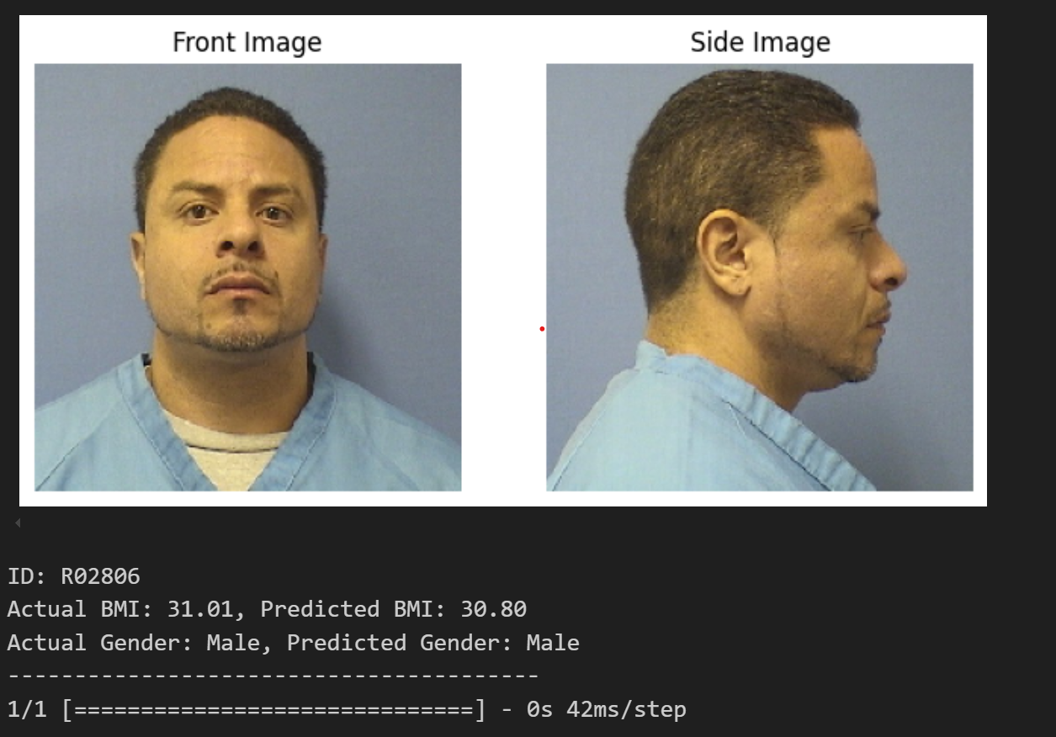

Slide 10
